Slide 1
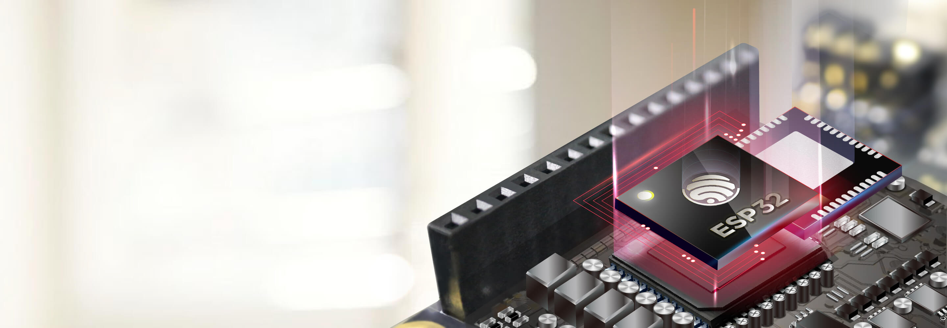
Dormitory intelligent switch light
System based on snap finger response
GROUP MAMBER: 李和沛，翁浩，黄一航，王子鑫

Slide 2
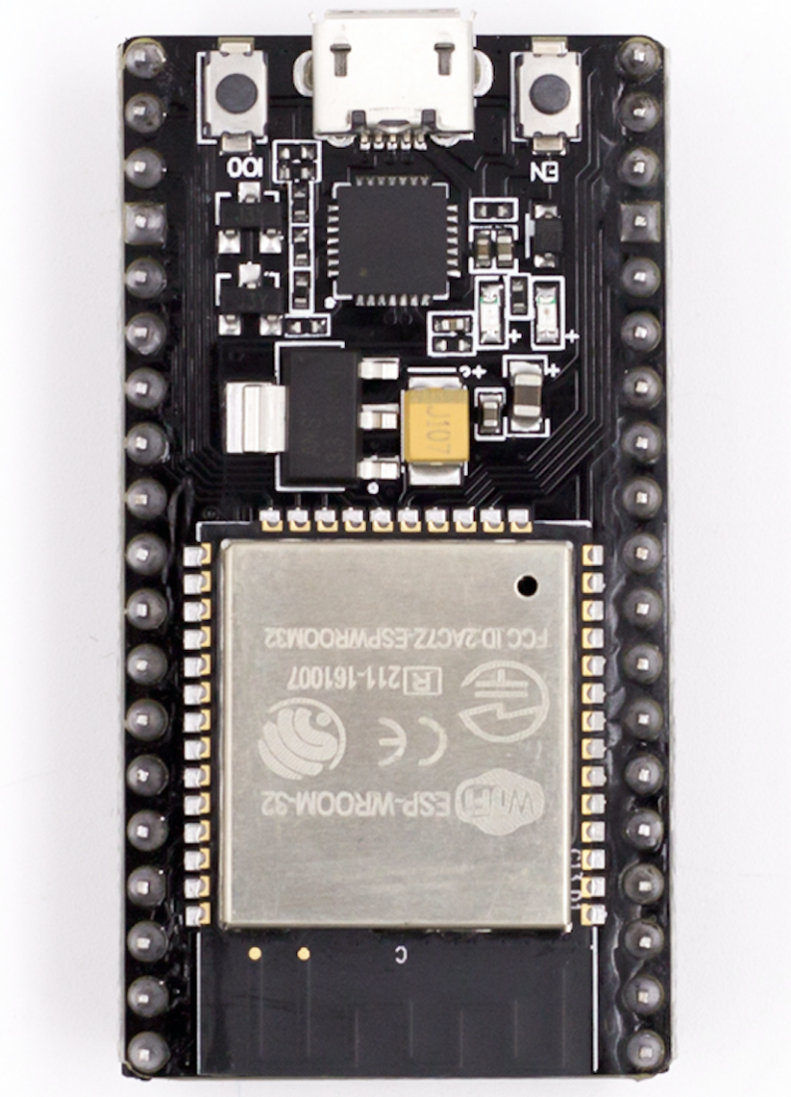
CONTENTS
01
Overall Architecture
02
Signal-Server
03
Control-Bridge and Motor-Actuator
04
Demo Video

Slide 3
01
Overall Architecture

Slide 4
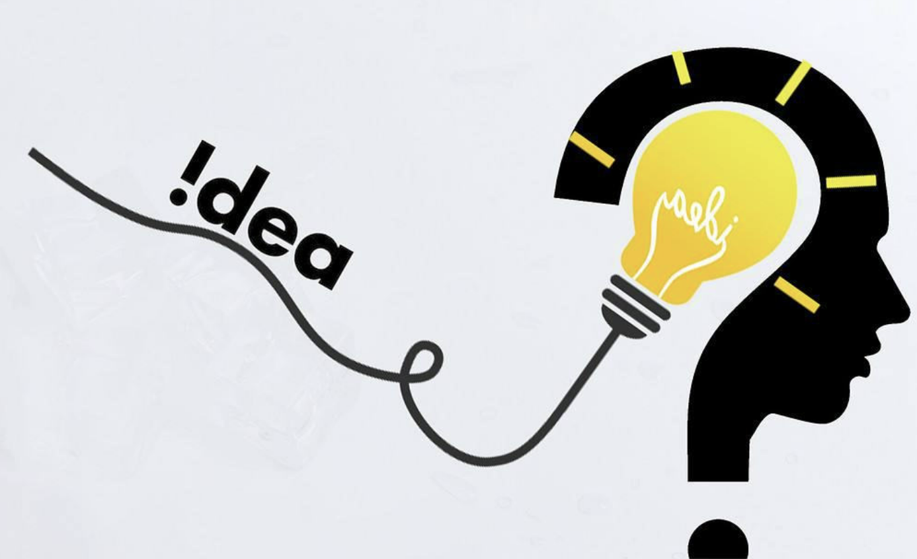
Why
Every night we end up cozy in bed only to realize the lights are still on—and there's zero chance we are crawling out to turn it off.

Slide 5
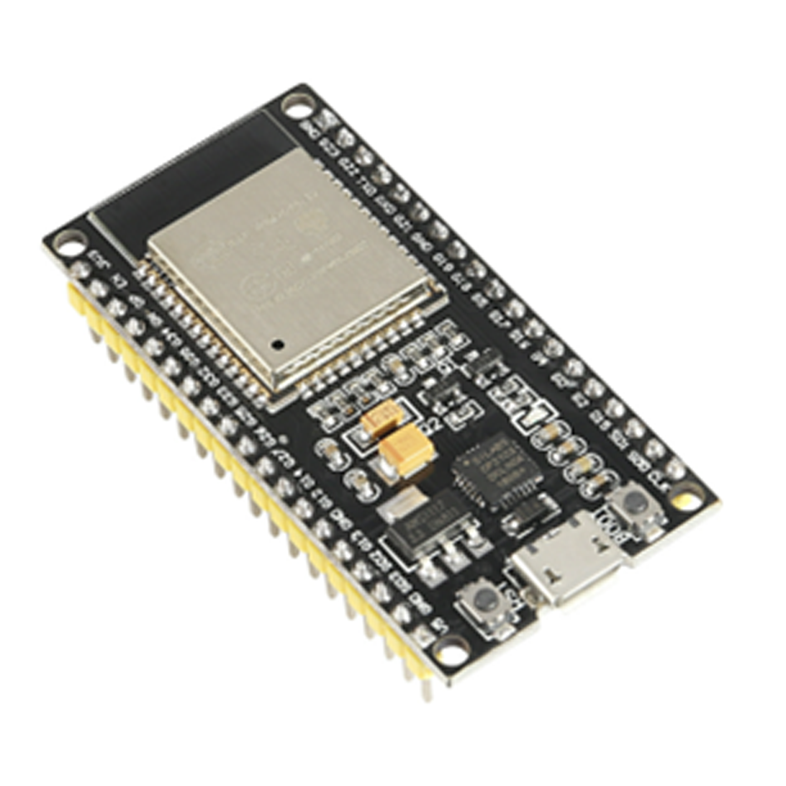
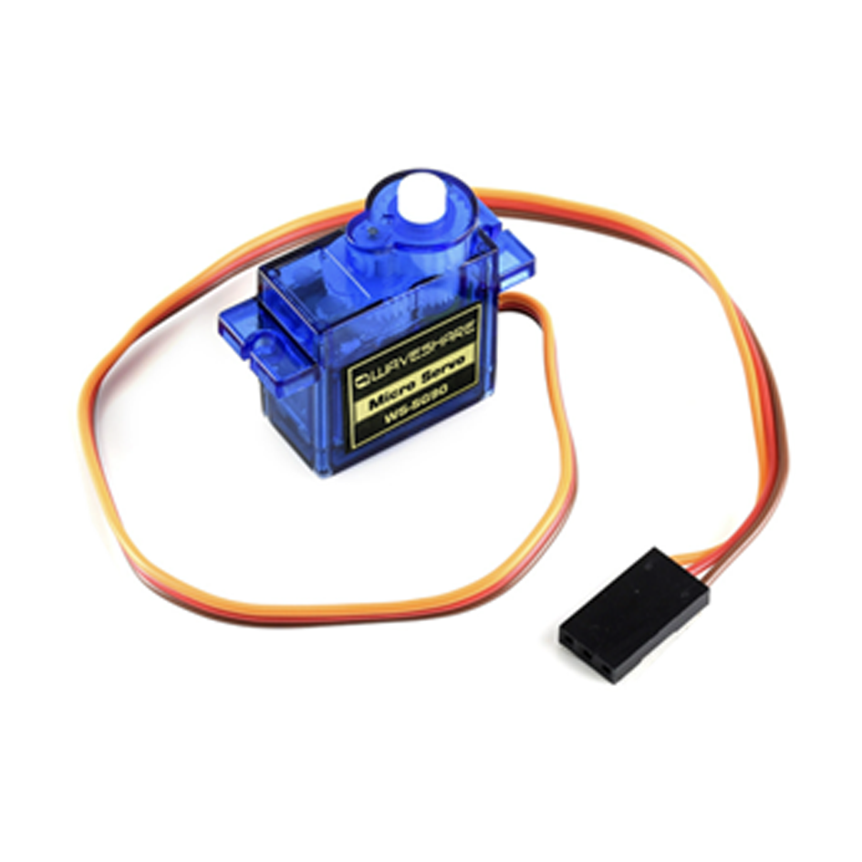
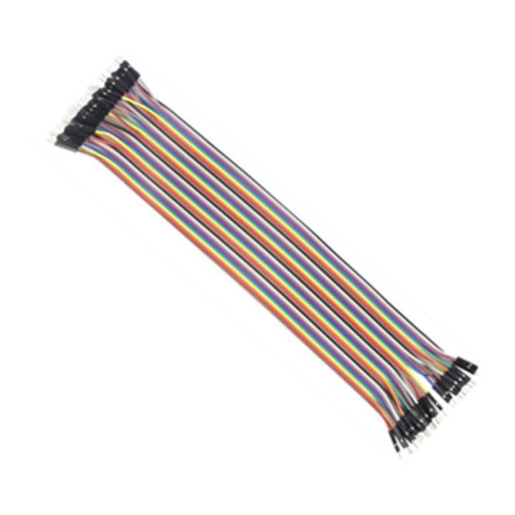
What devices
ESP32
SG90
Dupont line

Slide 6
Workflow
Motor-Actuator
Snap!
Pyaudio
Servo
Motor
Recognition Network
BLE Server
Bleak
Switch!
Signal-Server
Control-Bridge
Bluetooth

Slide 7
02
Signal-Server

Slide 8
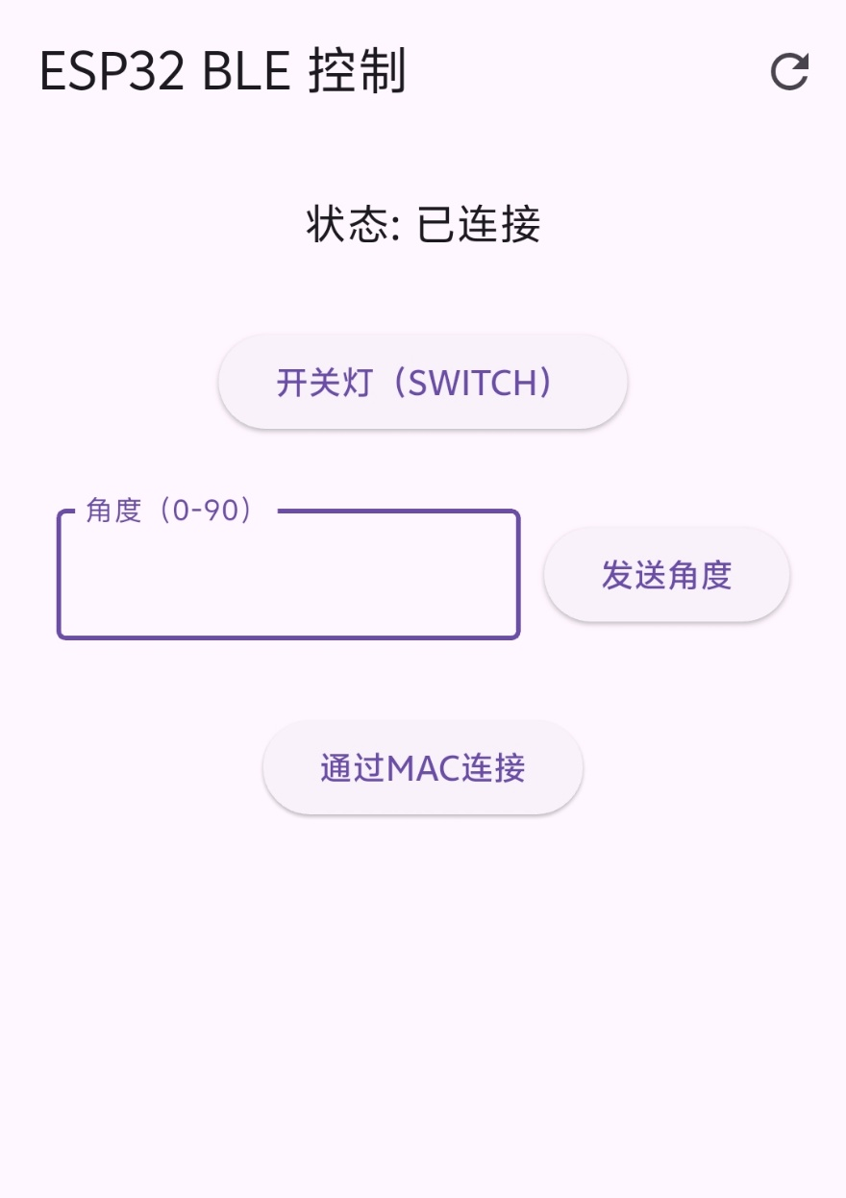
In mobile phone
In mobile phone, we use application to control it.
Lights can be controlled with a button, and it’s convenient to debug.

Slide 9
In mobile phone
Motor-Actuator
Servo
Motor
Application
BLE Server
Switch!
Signal-Server
Control-Bridge
Bluetooth

Slide 10
In host computer
Pyaudio:
A python library which can record audio in the environment
Recognition Network:
Serial networks which can recognize whether the input audio is a snap or not
Bleak:
A python library to send Bluetooth signals
Pyaudio
Recognition Network
Bleak

Slide 11
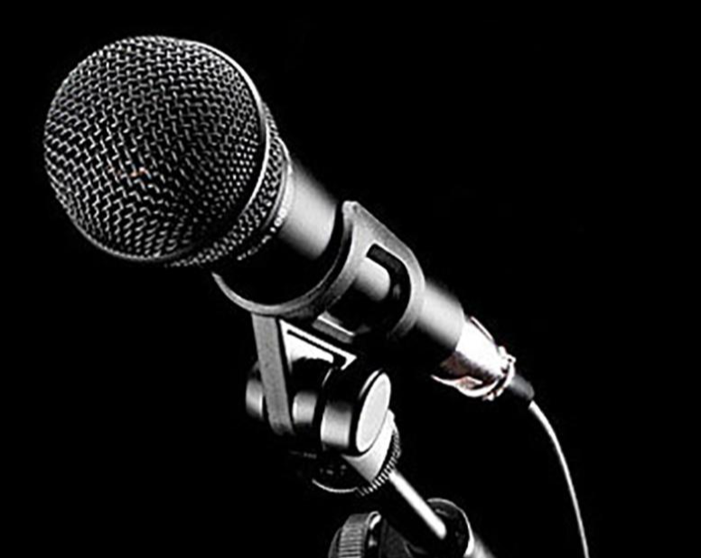
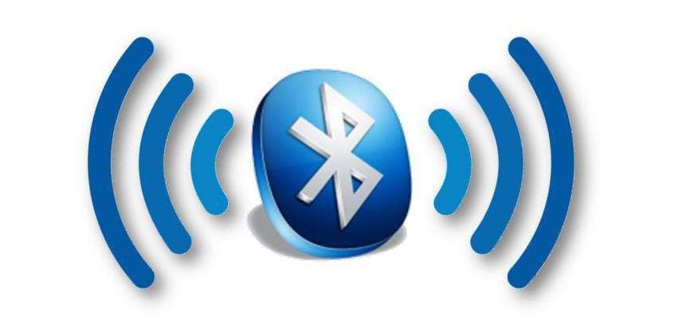
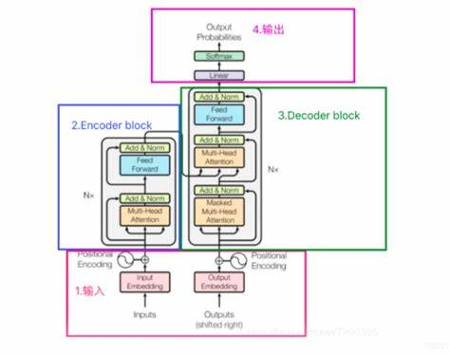
In host computer
Record once a second
Send SWITCH Signals
Record
Bluetooth
Recognize Snaps
Check
conditions
IsSnap

Slide 12
IsSnap
Recorded
Audio
Wav2Vec2Feature
Extractor
Result
WavLMForXVector
Cosine
Similarity
Local Snap Sample
Pretrained Model: https://github.com/TheKOG/InfinityGauntlet

Slide 13
IsSnap
Audio Feature Extraction
Recorded
Audio
Wav2Vec2Feature
Extractor
Result
Audio Waveform
WavLMForXVector
Cosine
Similarity
Audio Feature Embedding
Local Snap Sample
Pretrained Model: https://github.com/TheKOG/InfinityGauntlet

Slide 14
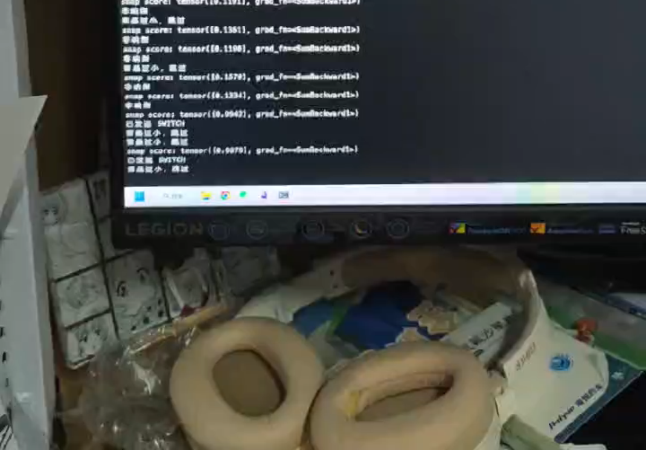
IsSnap

Slide 15
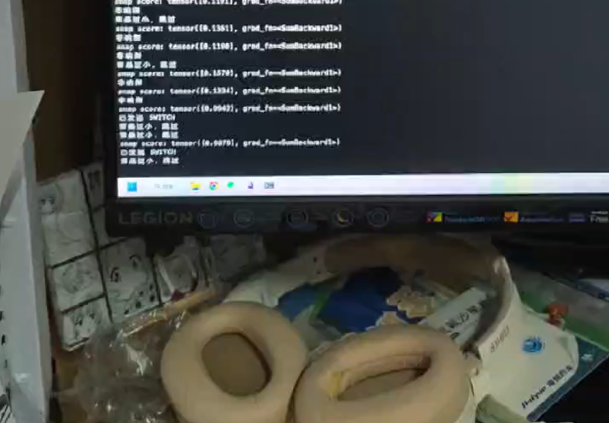
IsSnap
Snap Score:
Tensor([0.9678])

Slide 16
03
Control-Bridge and Motor-Actuator

Slide 17
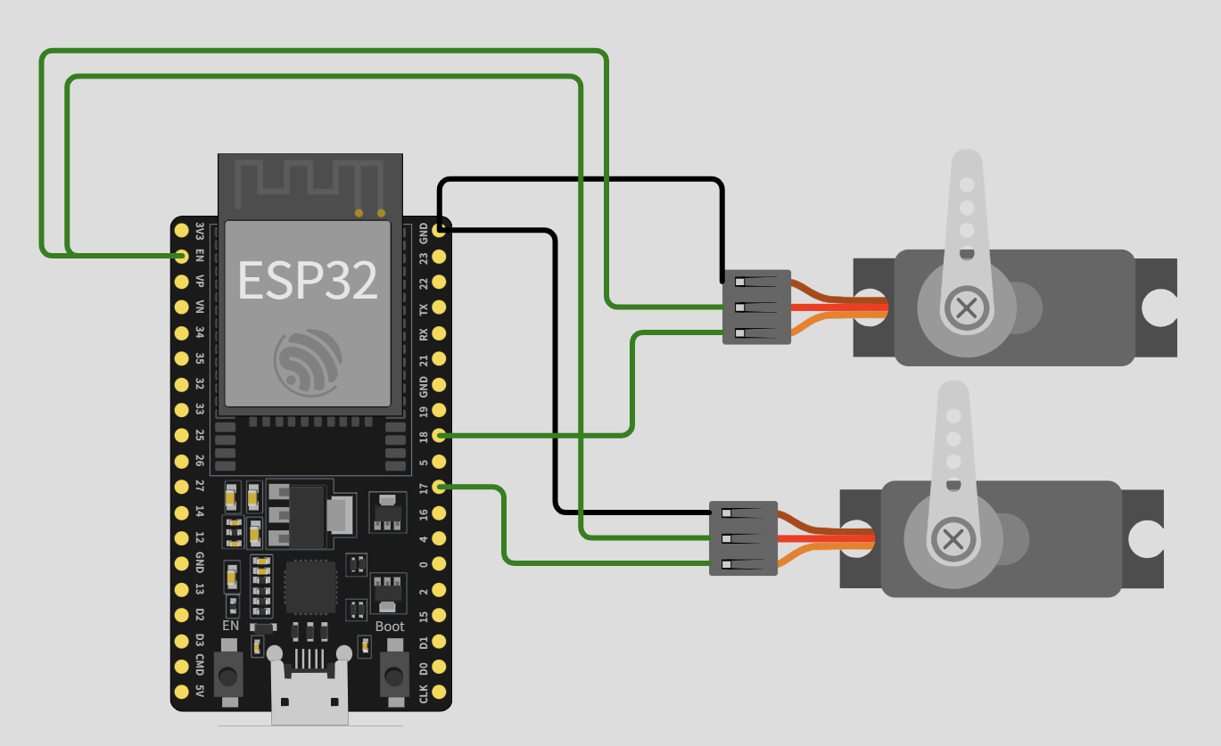
Simulate
Servo
Motor
BLE Server
Switch!
Control-Bridge

Slide 18
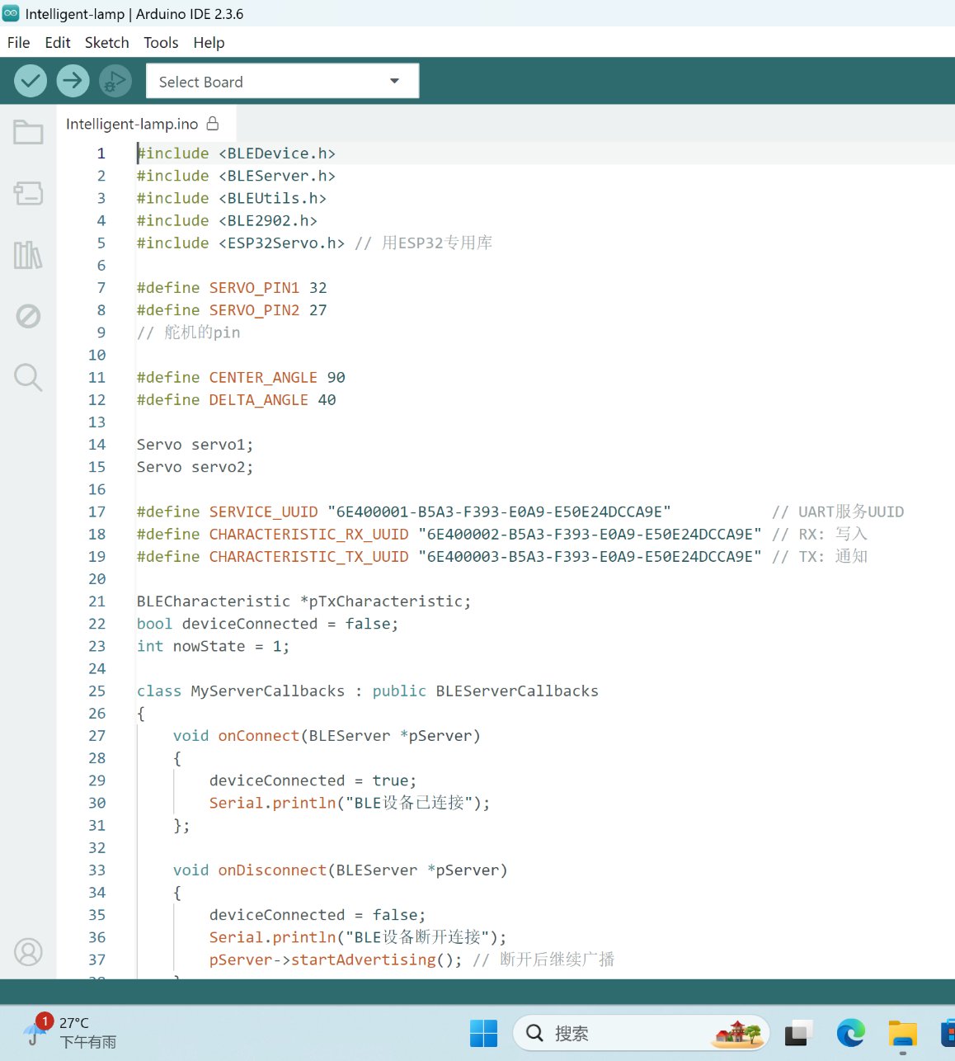
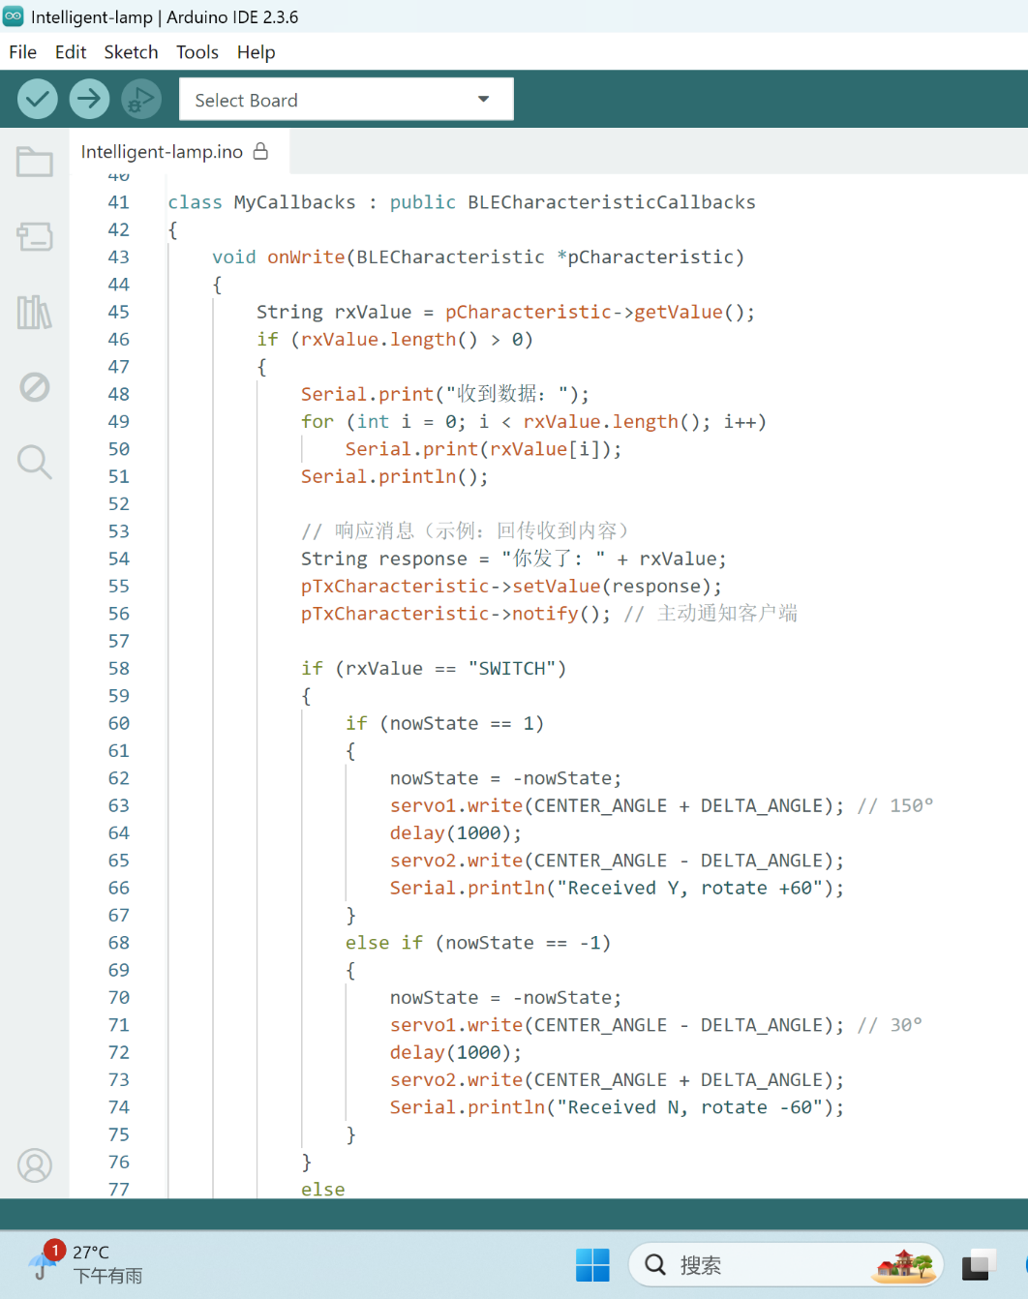
In Arduino

Slide 19
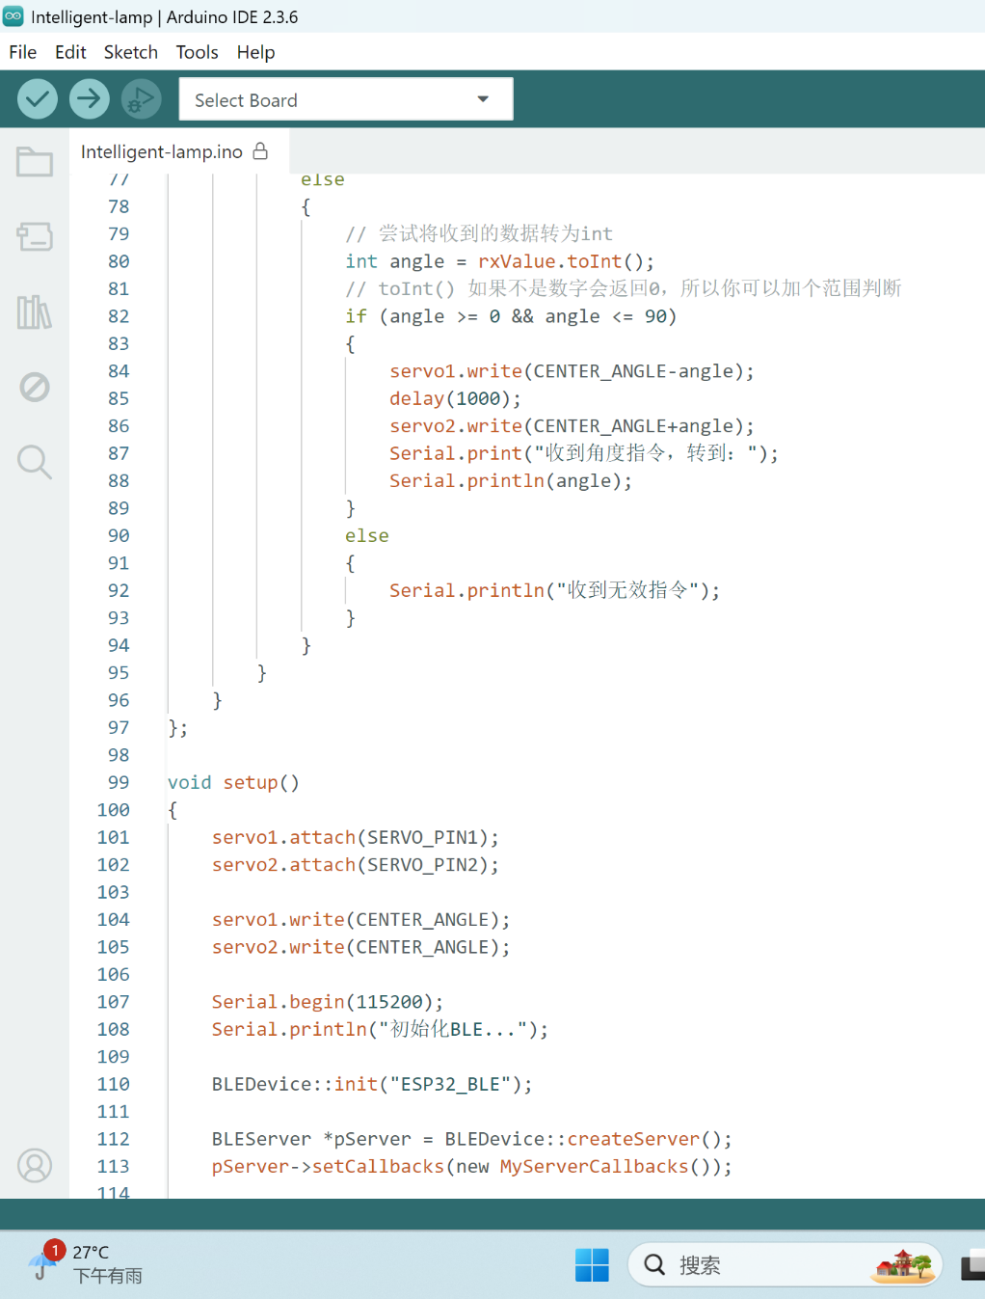
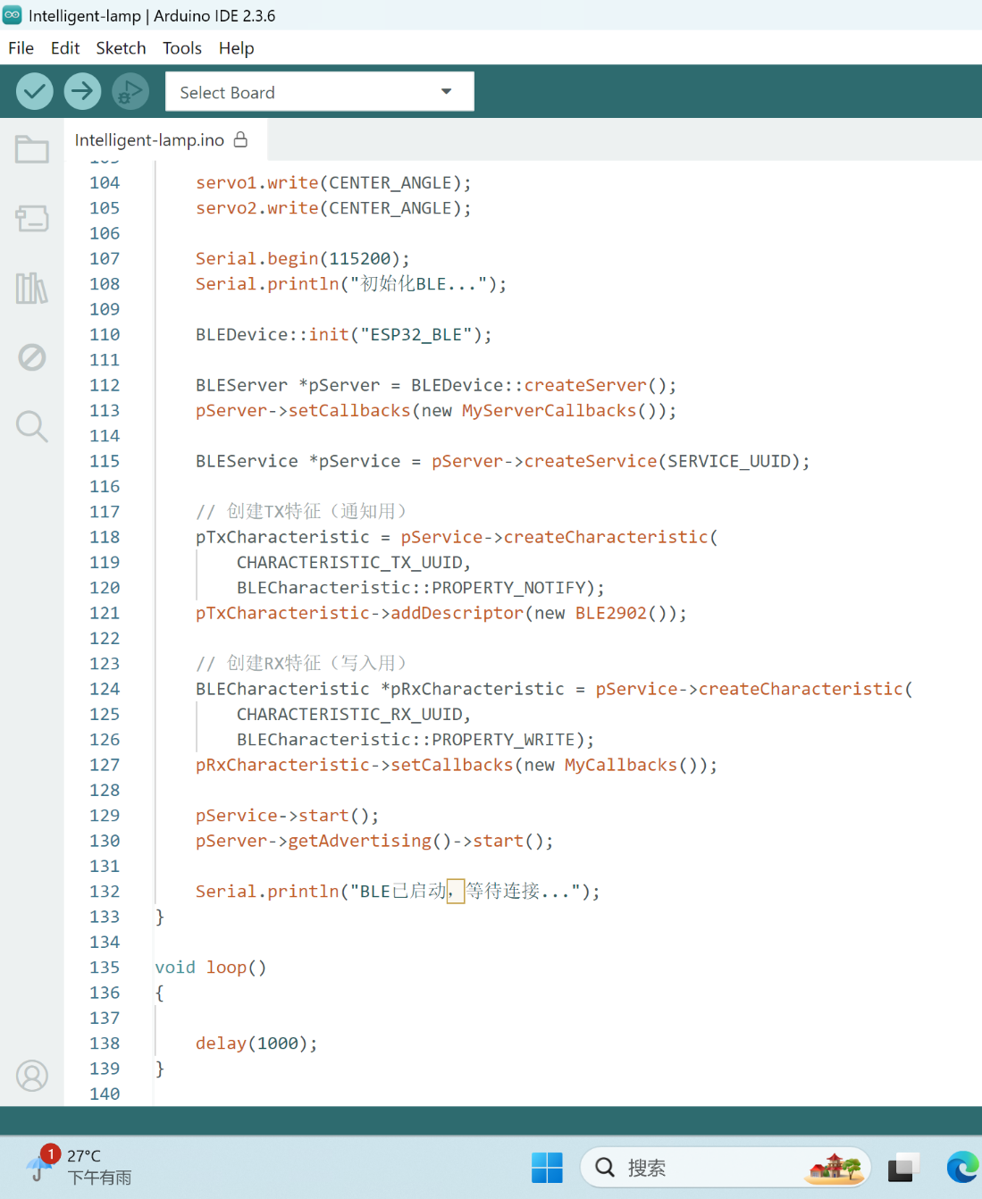
In Arduino

Slide 20
program
→
→
→
Device_connnect
→
Initial servo
Initial serial
Initial BLE_DEVICE
Receive data
?
SWITCH
Angle
invalid
on connect
On disconnect
Turn on/off the light
Turn to a angle

Slide 21
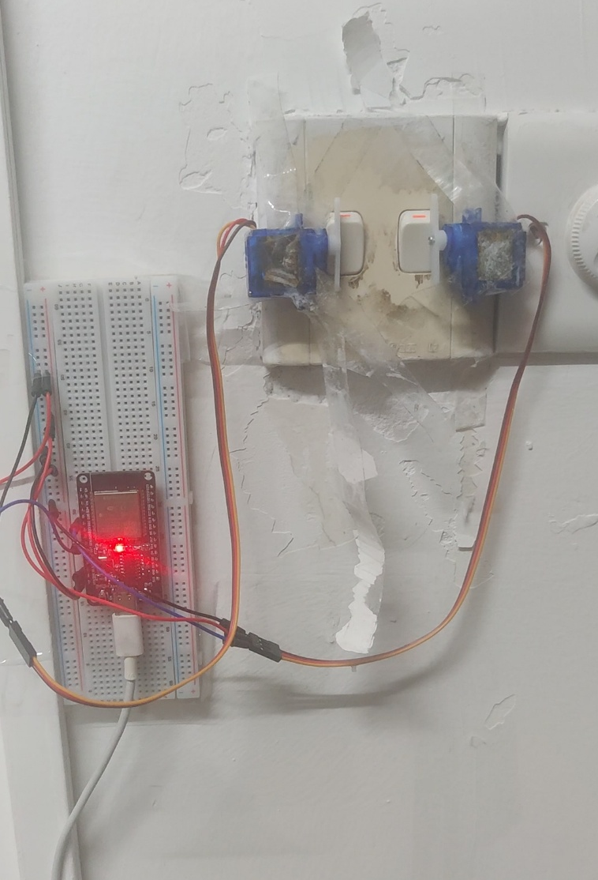
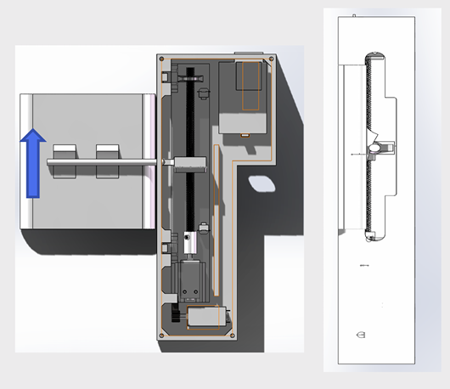
About hardware
What we do:
Given in the example:

Slide 22
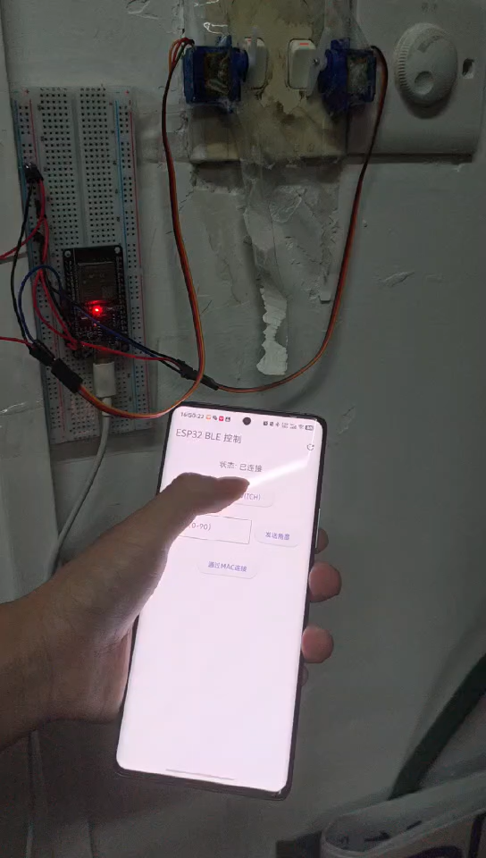
How it works
Use mobile phone to control it.

Slide 23
04
Demo
Video

Slide 24

See LHP:

Slide 25
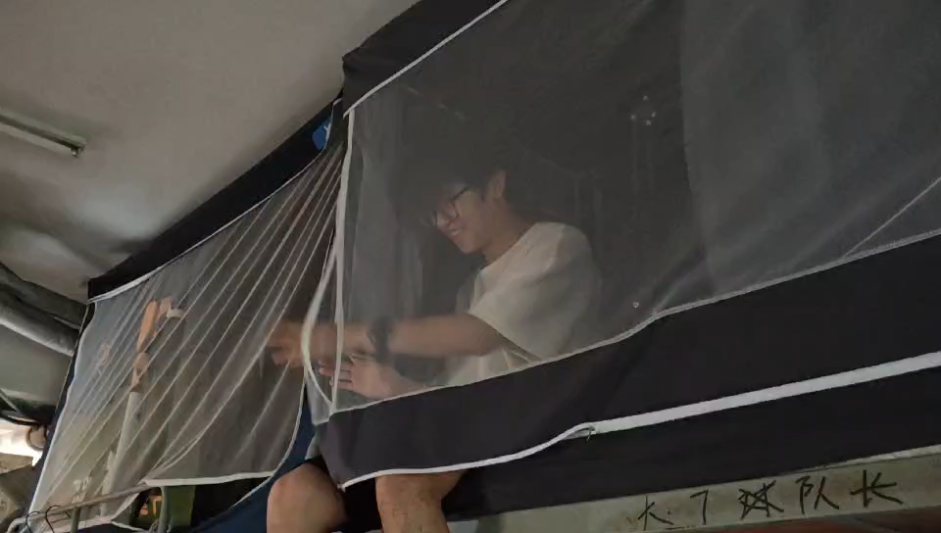
See LHP:

Slide 26
THANK YOU

